Slide 1
Chi-square test of Independence: Analyzing categorical variables
a researcher was interested in whether animals could be trained to line dance.
He took 200 cats and tried to train them to line dance by giving them either food or affection as a reward for dance-like behavior. At the end of the week they counted how many animals could line dance and how many could not.
There are two categorical variables here: training (the animal was trained using either food or affection, not both) and dance (the animal either learnt to line dance or it did not).

Slide 2
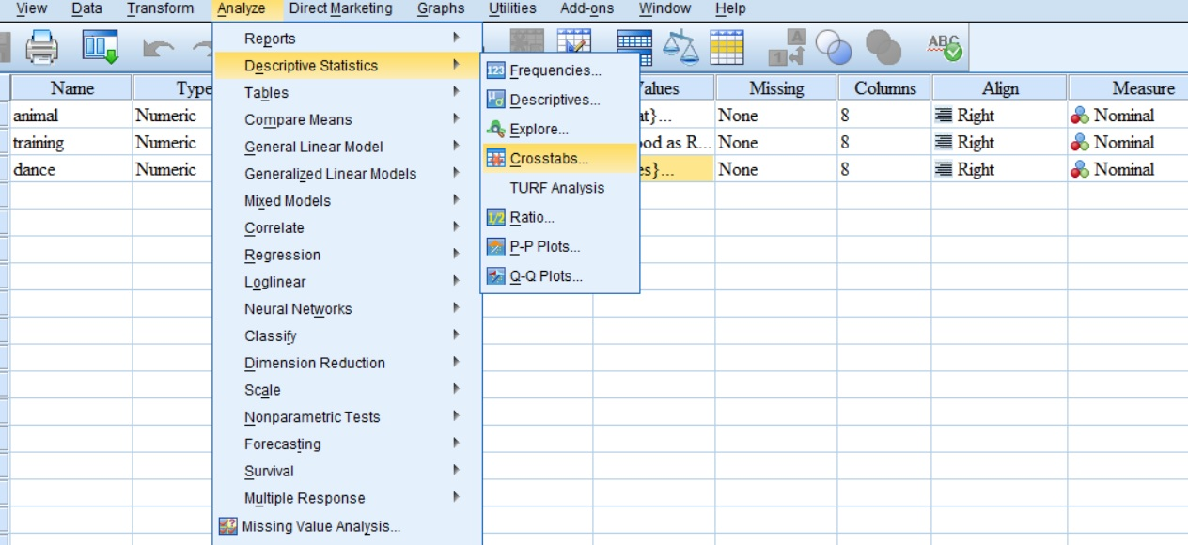
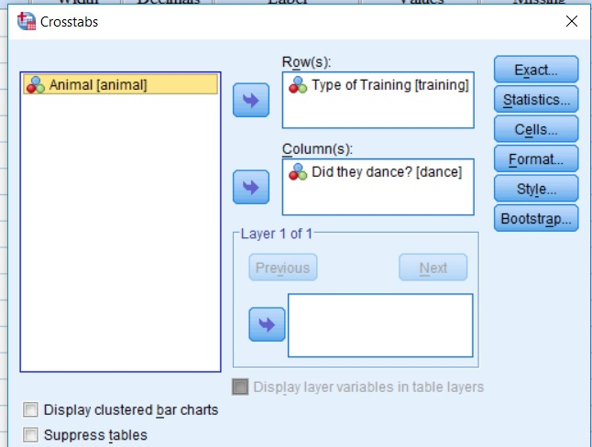
Running the analysis: procedure

Slide 3
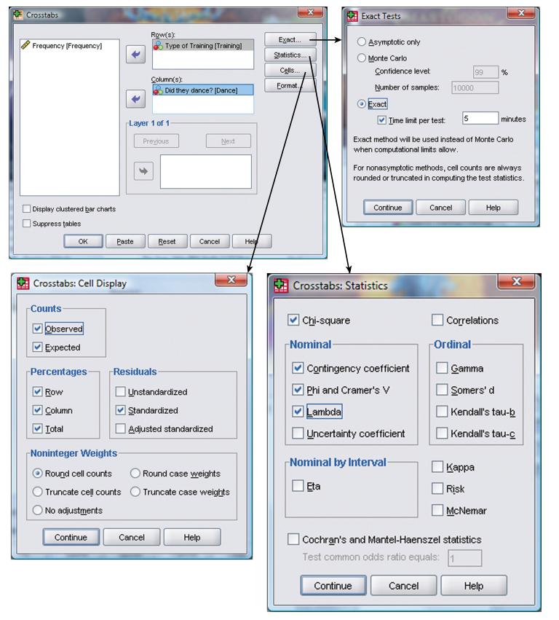

Slide 4
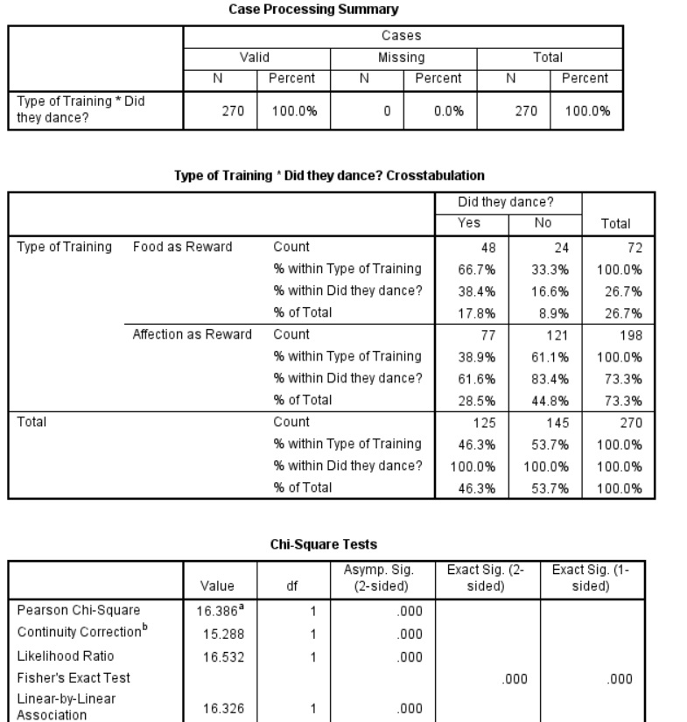
Out put

Slide 5
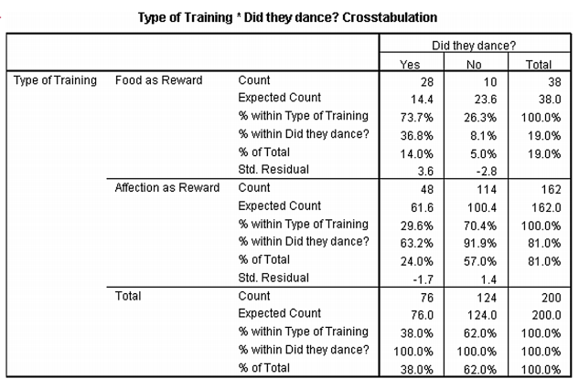
Another example

Slide 6
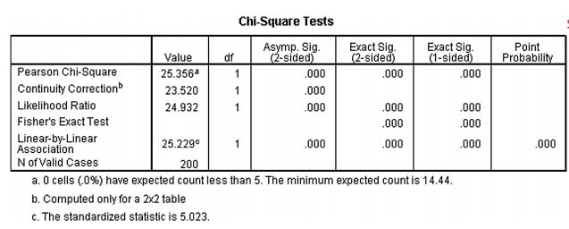
The value of Chi-square is highly significant (p < .001), indicating that the type of training used had a significant effect on whether an animal would dance.
The highly significant result indicates that there is an association between the type of training and whether the cat danced or not. What we mean by an association is that the pattern of responses in the two training conditions is significantly different.
This significant finding reflects the fact that when food is used as a reward, about 74% of cats learn to dance and 26% do not, whereas when affection is used, the opposite is true
Therefore, we can conclude that the type of training used significantly influences the cats: they will dance for food but not for love!

Slide 7
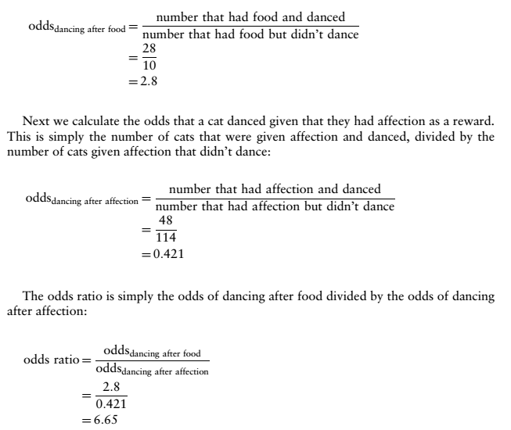
Calculating effect size

Slide 8
Reporting Chi square
There was a significant association between the type of training and whether or not cats would dance χ2 (1) = 25.36, p < .001. This seems to represent the fact that, based on the odds ratio, the odds of cats dancing were 6.65 times higher if they were trained with food than if trained with affection.

